Slide 1
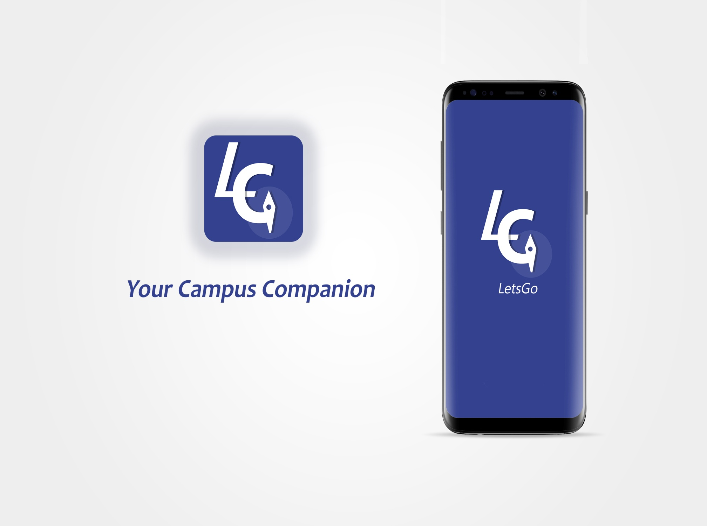
0

Slide 2
Introduction
LetsGo is an app used to locate the various lecture theaters, event hubs in the school.
1
Notes:
Letsgo is an application inspired by the struggles I had to go through as a L100 student to find the various lecture theathres

Slide 3
Objective &Target
To assist students conveniently locate lecture theaters easily
Target
Students
Resource personnel at the various events in the School

Slide 4
Problem It Addresses
Allows students locate the various lecture hall with ease
Allows students locate the various Landmarks in the school
Eliminate unnecessary human interaction

Slide 5
Alternative Products
Google maps
HereWeGo
Offline Maps and Navigation
Maps.Me
Stand-alone

Slide 6
Competitive Edge
Fully functional offline
Efficient since it conserves battery life
No additional downloads in order to use software

Slide 7
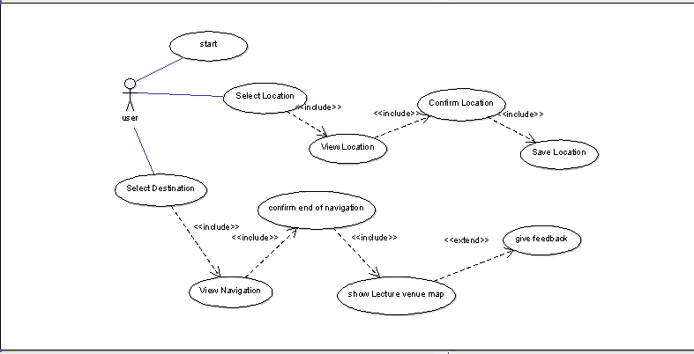
System Model
Use case diagram(Interactional Model)

Slide 8
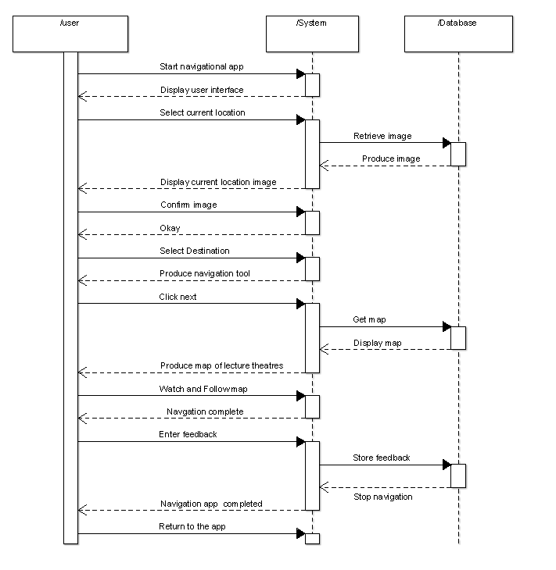
Sequence Diagram( Behavorial model)

Slide 9
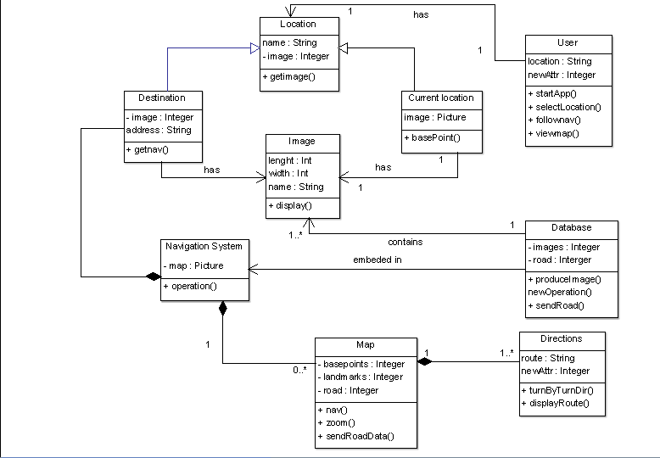
Structural Model
CLASS DIAGRAM

Slide 10

Team
Dennis Effa Amponsah | John Paakwesi Erbynn | Kwabena Afriyie-Gyamfi | Isaac Agyen Duffour | Laud Boakye Ansah
PS/CSC/15/0004 Amponsah @gmail.com | PS/CSC/15/0006 John.erbynn@gmail.com | PS/CSC/15/0007 kafriyiegyamfi@gmail.com | PS/CSC/15/0049 izagyen96@gmail.com | PS/CSC/15/0039 laudboakyeansah200@gmail.com

